Slide 1
Achieving Business Impact with Data

Slide 2


Speaker
Insert
Speaker
Photo
Liyan
Wang
Data Analyst Intern

Slide 3
Agenda
1
3
Introduction
Recommendations
2
4
Project Review
Concluding Thoughts

Slide 4
Introduction

Slide 5

Project Goal
Build customer and asset profiles to reduce churn and improve sales performance
Notes:
Why is this goal important? How can achieving it help the company?
Churn rate is crucial for a SaaS company like Showpad. Having the ability to predict which customers are likely to churn, the company is then able to
Take proactive actions in order to prevent the customer from churning → employees, such as customer success team, can be more engaged with the customer and focus on those likely to churn
Allocate and manage resources more strategically → employees, such as sales team would follow the winning patterns to adjust sales process and win more opportunities

Slide 6



Project Review
Customer Health Score
Asset Health Score
Sales Performance Asset Activity Correlation

Slide 7
Customer Health Score
Notes:
Objective is collaborate with legal tema to build customer profile using models to find answers for:
What factors lead a customer to churn
How likely a customer will churn
What score a customer should be labeled in terms of risk to churn

Slide 8




Data Processing
Data Cleaning
Data Transformation
Dimension
Reduction
Modeling
Notes:
Data Cleaning
Remove missing values/irrelevant records & variables from dataset
Data Transformation
Group variables/fields into categories/classes
Use numbers instead of words to represent categories/classes
Dimension Reduction
Use machine learning algorithm to screen out unimportant variables to reduce number of variables fed into models

Slide 9
Model Variables
Legal
Terms
Termination
Rights
SLA
Renewal
ARR
Segment
Security
Breach
Package
Notes:
Important features from final model are rooted from 7 parent variables shown
*** 1,036 records and 36 variables used
67/33 split of training and test
12 models were built using different classification algorithms.
The best model was using logistic regression with L1 penalty, which had an accuracy of 74.27% on test data.
10 fold cross validation: Overall Accuracy: 68% - 74%

Slide 10
Breaking Down the Variables
More Likely to Churn |  | Less Likely to Churn
Legal Terms 2016 | 1.40 | Large Renewal ARR | -5.63
Outdated DPA | 1.33 | Negotiated DPA | -1.74
No SLA | 0.64 | Ultimate Package | -1.25
Professional Package | 0.48 | No DPA | -0.43
Termination for Convenience | 0.39 | Legal Terms 2018 | -0.33
Notes:
In this table, the left section indicates having such variables customers are more likely to churn and variable weights. The right section is the opposite.
For instance, customers having legal terms of 2016 are more likely to churn comparing to having legal terms of 2018. This would make sense because 2016 is way too outdated. Another example would be customers using professional package are more likely to churn because this product is no longer available and those who subscribe to ultimate package are less likely to churn.
Also note that having a large renewal ARR is less likely to churn and this is the most important feature in determining whether a customer will churn. One possible reason is that only big companies would be able to pay such a large amount of money and they are cautious about platform switching.

Slide 11

Churn Prediction
Probability_{churn} = 1/(1+𝑒^(−𝑥) )
***X = -0.23 + 0.39 (termination_rights_2) – 0.33 (legal_terms_3) – 0.06 (legal_terms_4) + 1.40 (legal_terms_5) + 0.64 (sla_1) – 0.43 (sec_breach_note_1) – 1.74 (sec_breach_note_2) +
0.61 (sec_breach_note_3) + 1.33 (sec_breach_note_4) + 0.35 (package_1) + 0.48 (package_4) –1.25 (package_5) – 0.12 (segment_0) + 0.10 (segment_1) – 5.63 (renewal_ARR)
Notes:
Now we have the estimate of each important features, we can compute the effect of features then calculate the probability of churn using the formula listed. To compute the effect, we just simply plug in the scenario of one customer using the bottom formula.

Slide 12
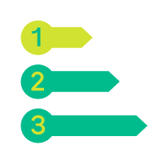


Data Conclusions
Five-Scale Score:
1 = unlikely to churn
5 = very likely to churn
Sweet Spot:
MM, Ultimate, High Renewal ARR
Push for up-to-date legal terms & conditions
Notes:
To conclude, now we have the probability of churn for each customer, we can assign a five-scale score by sorting the probability in ascending order, first ⅕ of probability are labeled 1, meaning unlikely to churn. The last ⅕ with large number of probability are labeled 5 meaning very likely to churn.
From model outputs, we can find sweet spot is mid market customer with high renewal ARR and choose ultimate package
We’d also like to push for up-to-date legal terms and conditions as outdated legal terms has great impact on customer churning

Slide 13
Asset Health Score
Notes:
Objective is to build asset profile by
Creating lifetime engagement and recent engagement of marketing-created assets in Showpad library
Creating an “asset health score” for each marketing-created asset in Showpad library from all engagement data
Visualize the health scores with an Experience App

Slide 14



Source Datasets
Library Marketing Content Export
User Activity Export
Top Content Marketing Export

Slide 15
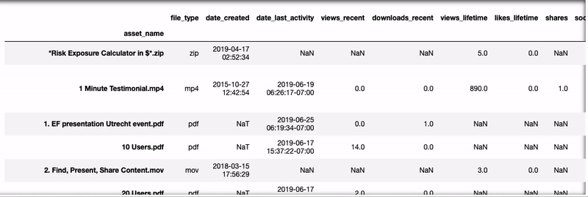
Merged Table
Notes:
Merged table has data extracted from 3 data sources.
Additional columns were created to indicate which dataset the data is from. The last column is the score calculated from recent view, lifetime view and shares. Each variable shares an equal weight, ⅓ .

Slide 16
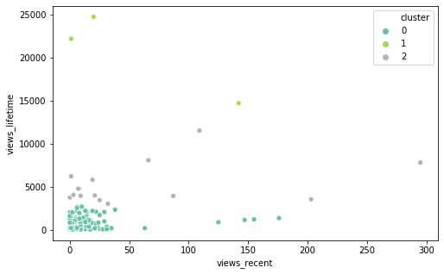
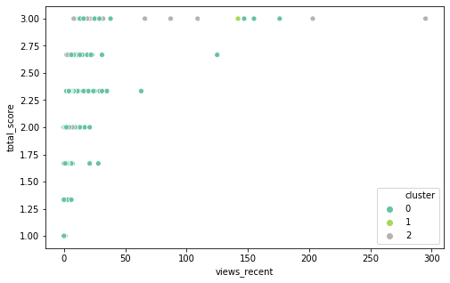
Visualization after Clustering
3 clusters generated from K-means clustering
Views_recent vs view_lifetime Scatterplot
Views_recent vs total_score Scatterplot
Notes:
When we have asset score, k-means clustering(creating groups based on similarities) was performed to create three cluster comparing asset performance.

Slide 17
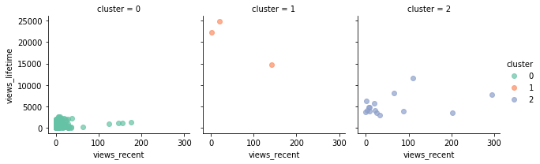
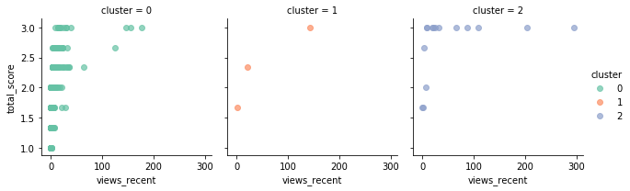
Details in Clusters
Notes:
Cluster 0 in color teal, located in the bottom left corner, has relatively low recent view and lifetime view. Scores are scattered.
Cluster 1 in color coral, located sparsely in the top left corner and in the middle, has low to medium recent view and medium to high lifetime view. Scores on average are in the middle.
Cluster 2 in color lavender, has the widest range of recent view and medium lifetime view. Scores are mostly 3, which is the highest.

Slide 18
Sales Performance Asset Activity Correlation
Notes:
how asset engagement during a sales cycle correlates to win rate, deal size, and/or sales cycle length.

Slide 19




Source Datasets
Asset Health Score
SFDC Report
Opportunity Export
Opportunity History Export

Slide 20
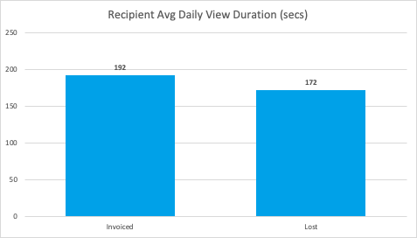
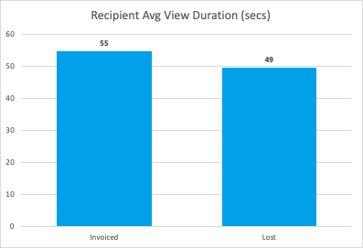
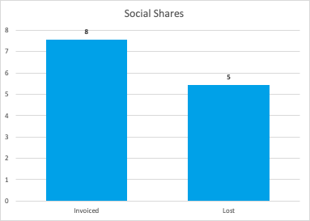
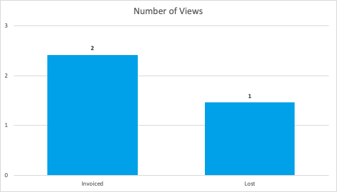
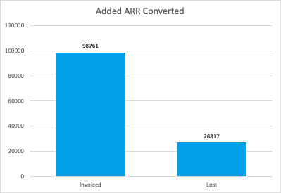
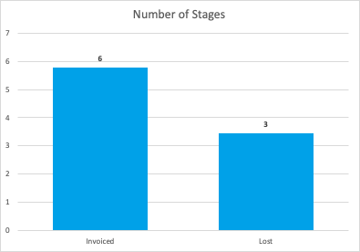
Average Comparison
Notes:
First exploration was comparing averages between winning and lost opportunities. The left bar in each subplot represents winning opportunities and the right bar is lost opportunities. The highlighted parts are the differences. These are the only 6 scenarios where winning opps have higher average than lost opps.

Slide 21




Winning Opportunities are...
20s ↑ daily
6s ↑ on average
3 ↑ social shares
3 times ↑ ARR
3 ↑ sales stages
Notes:
Recipients of winning opportunities spend 20 more seconds daily than those of lost opportunities
Recipients of winning opportunities spend 6 more seconds than those of lost opportunities
Assets used in winning opportunities have 3 more social shares than those used in lost opportunities.
ARR of winning opportunities is approximately 3 times larger than lost opportunities.
Winning opportunities go through 3 more stages(last stage is invoiced) to achieve final goal than lost opportunities

Slide 22
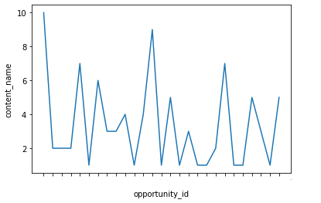
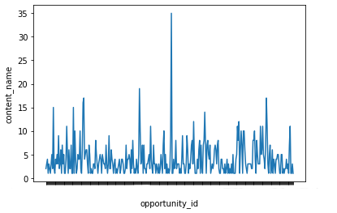
Asset Usage Comparison
It could be a "lost" signal when more than 10 assets are utilized in one opportunity.
Number of Assets Used in Winning Opportunities
Number of Assets Used in Lost Opportunities
3
3
Notes:
Two graphs show how many assets were used in one opportunity. The red line means that on average 3 assets were used for a winning opportunity and this pattern was maintained in lost opportunities. The maximum number of asset used in winning opportunity was 10 compared to 35 in a lost opportunity. It could be a "lost" signal when more than 10 assets are utilized in one opportunity.

Slide 23
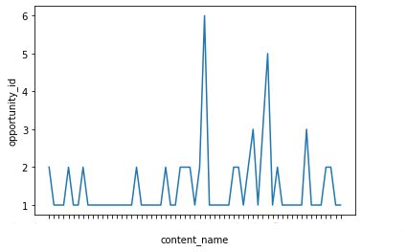
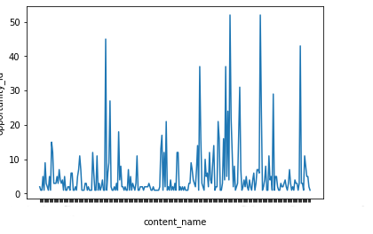
Asset Reusability Comparison
High Reusability + Lost Opportunity ≠ Causality 🙅
Showpad Overview Deck.pdf
Showpad for Marketing One Pager.pdf
Frequency of Assets Used in Winning Opportunities
Frequency of Assets Used in Lost Opportunities
Salesforce Integration One Pager.pdf
Showpad Platform Discovery & Vision Deck.pdf
DEPRECATED_Showpad Messaging Deck.pdf
Why Showpad Video.mp4
2
Notes:
Two graphs show how many opportunities shared the same asset. An asset could be customized for an opportunity and hence used in only one opportunity or was created for a general purpose and could be reused multiple times. On average, an asset was used in only one winning opportunity while it was used at least twice in lost opps.
The highlighted circles are the most frequently used assets in both categories. Now we know what most frequently used assets are, does it mean when we share these assets, we will win or lose the opportunity? No. This is not a causation but it would be interesting to find out why they are correlated in the future.

Slide 24




Pairwise Correlations
“You jump, I jump.”
Lifetime view, Social Shares
In-app Number of Views, Shares
Total time spent, number of view
Recent View, Recipient Number of Views, Recipient Viewers, Shares
Notes:
After exploratory analysis, I was looking at variable correlations. These 4 groups all show positive correlation, which means when you observe an increase in any of these variables within the group, you can expect a growth in the rest variables. That is “you jump, I jump” relationship.

Slide 25

Data Mining
Correlations
Modeling
Insights
Notes:
Now it’s clear how variables are correlated and then we run machine learning algorithms to find what features will determine the final opportunity status.

Slide 26




Winning Patterns💡
More than $20,000 ARR
Less than 400-day sales cycle length
Average 6 sales stages
Asset within 5,000 lifetime views

Slide 27
Recommendations

Slide 28



The Focus Moving Forward
Standardization
Connection
Integration
Notes:
Standardization
Create a standardized format of fields → less transformation, better merge with other datasets for robust model prediction
More detailed sales performance record of clearer sales stage changes → analyze when or whether assets play a role in winning opportunity
Connection
Pull data from salesforce, download as csv then read csv for data analysis → read data directly from the DB. Simplify data preparation/transformation step. Another advantage is when data changes, it is easier to automate ML model re-train process.
Integration
Data scattered in different tables, from DB perspective, a proper reference key minimize data loss when merging tables → keep tables organically connected

Slide 29
Concluding Thoughts

Slide 30

Notes:
Thanks to
Showpad for internship opportunity to work on different projects and make connections with people
James for continuous support and Chris and Matt for collaboration and great teamwork on Hackathon
Michael for patience and guidance throughout internship, one-on-one meetings

Slide 31
Appendix
Notes:
*** Refer to Appendix for specific data points if needed/asked to reference them

Slide 32
Customer Health Score Model Outputs(1)
To identify factors that indicate a customer will churn
Model accuracy: 68% - 74%
Indicator | Representation | Estimate
termination_rights_2 | Yes - less than 90-day notice | 0.39
legal_terms_3 | Standard (MSA 1Apr18) | -0.33
legal_terms_4 | Standard (3Apr17) | -0.06
legal_terms_5 | Standard (15Nov16) | 1.40
sla_1 | SLA - No | 0.64

Slide 33
Customer Health Score Model Outputs(2)
To identify factors that indicate a customer will churn
Model accuracy: 68% - 74%
Indicator | Representation | Estimate
sec_breach_note_1 | No | -0.43
sec_breach_note_2 | Yes - within 24 hours of discovery | -1.74
sec_breach_note_3 | Yes - between 24-48 hours after discovery | 0.61
sec_breach_note_4 | Yes - greater than 48 hours after discovery | 1.33
renewal_ARR | Expected Renewal ARR | -5.63

Slide 34
Customer Health Score Model Outputs(3)
To identify factors that indicate a customer will churn
Model accuracy: 68% - 74%
Indicator | Representation | Estimate
package_1 | Enterprise | 0.35
package_4 | Professional | 0.48
package_5 | Ultimate | -1.25
segment_0 | MM | -0.12
segment_1 | ENT | 0.10

Slide 35
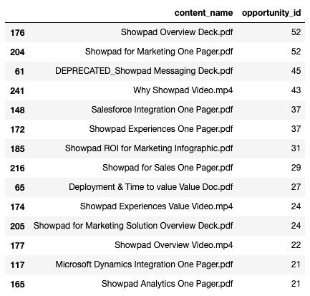
Asset Reusability Table(Lost)

Slide 36
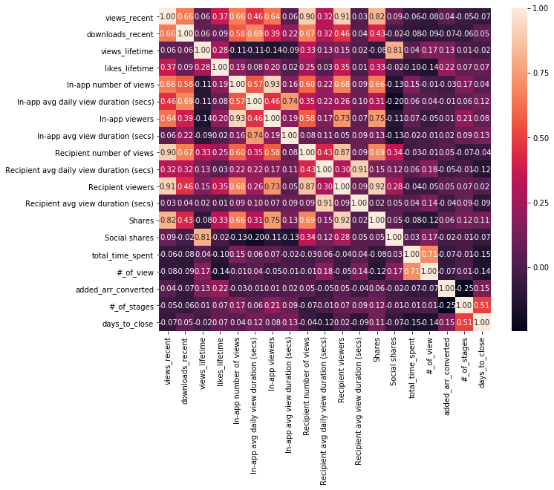
Correlation Matrix(Winning)

Slide 37
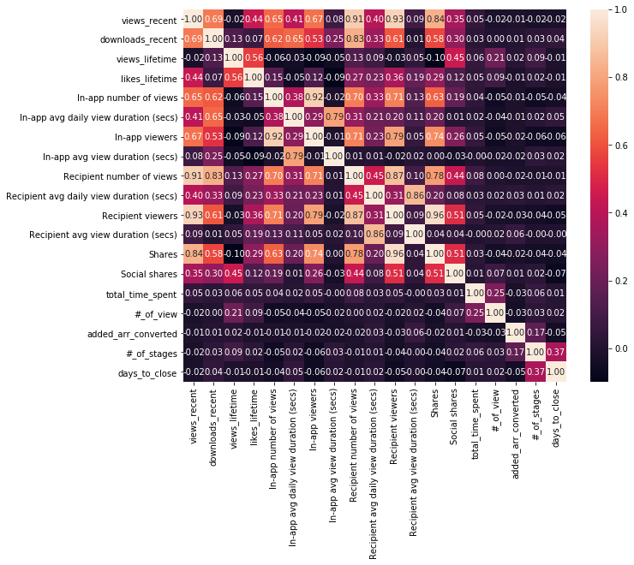
Correlation Matrix(Lost)

Slide 38
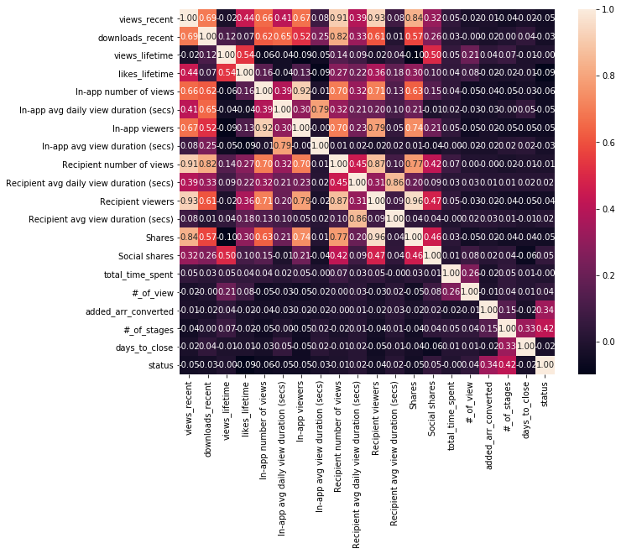
Correlation Matrix(Combined)

Slide 39
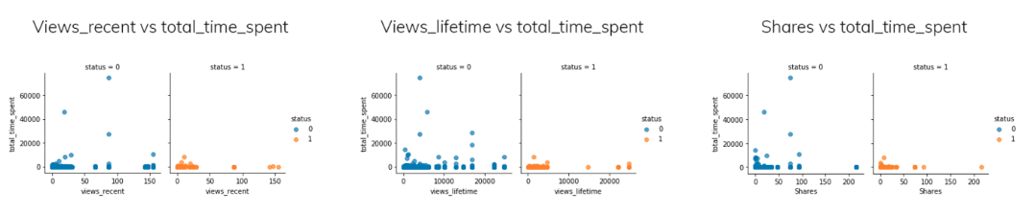
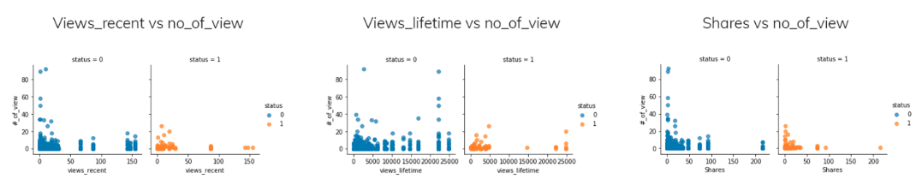
Latent Associations(1)

Slide 40
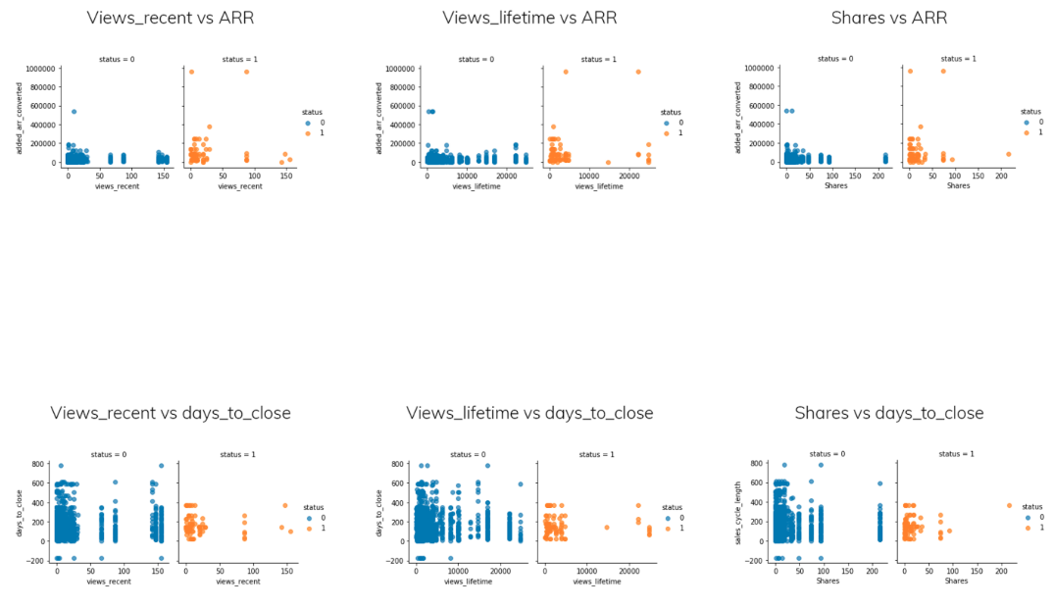
Latent Associations(2)

Slide 41
5 Number Summary of ARR
 | Winning | Lost
Mean | 98760.52 | 26816.72
Standard Deviation | 150285.78 | 33671.02
Min | 0.00 | 0.00
25% | 22500.00 | 12510.00
50% | 63176.40 | 20700.01
75% | 115639.00 | 34776.01
Max | 965057.00 | 538000.00

Slide 42
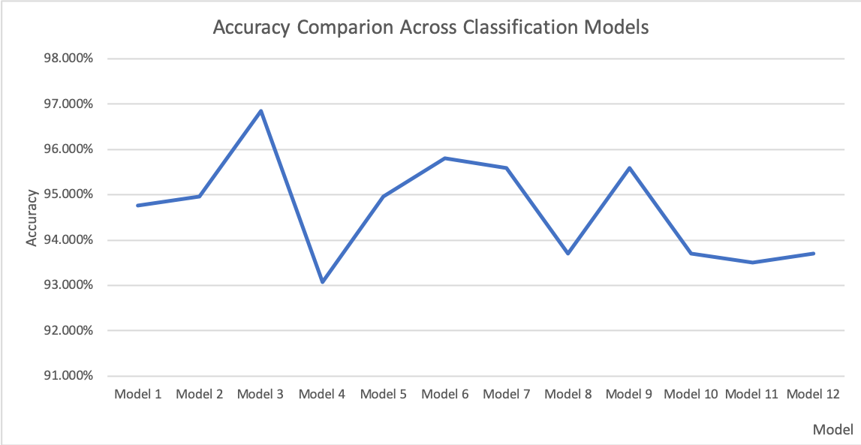
Classification Models
Model 1 using default settings(L2 penalty)
Model 2 using L1 penalty.
Model 3 using random forest 'gini' as measurement
Model 4 using naive bayes
Model 5 using k-nearest neighbor
Model 6 using linear discriminant analysis
Model 7 using neural network default
Model 8 using neural network logistic activation
Model 9 using neural network tanh activation
Model 10 using neural network sgd solver constant learning rate
Model 11 using neural network sgd solver invscaling learning rate
Model 12 using neural network sgd solver adaptive learning rate

Slide 43
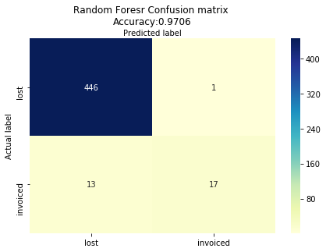
Random Forest Model
To predict opportunity status and identify factors that determine status
Model accuracy: 97.06%(needs improvement)
Indicator | Representation | Importance
added_arr_converted | ARR in USD | 0.32
#_of_stages | Number of Sales stages | 0.28
days_to_close | Sales cycle length | 0.07
total_time_spent | View duration in seconds | 0.07
views_lifetime | Views in library marketing content export | 0.03

